Slide 1
Python List
4110E219 喬安蒂

Slide 2
BASIC LIST OPERATIONS

Slide 3
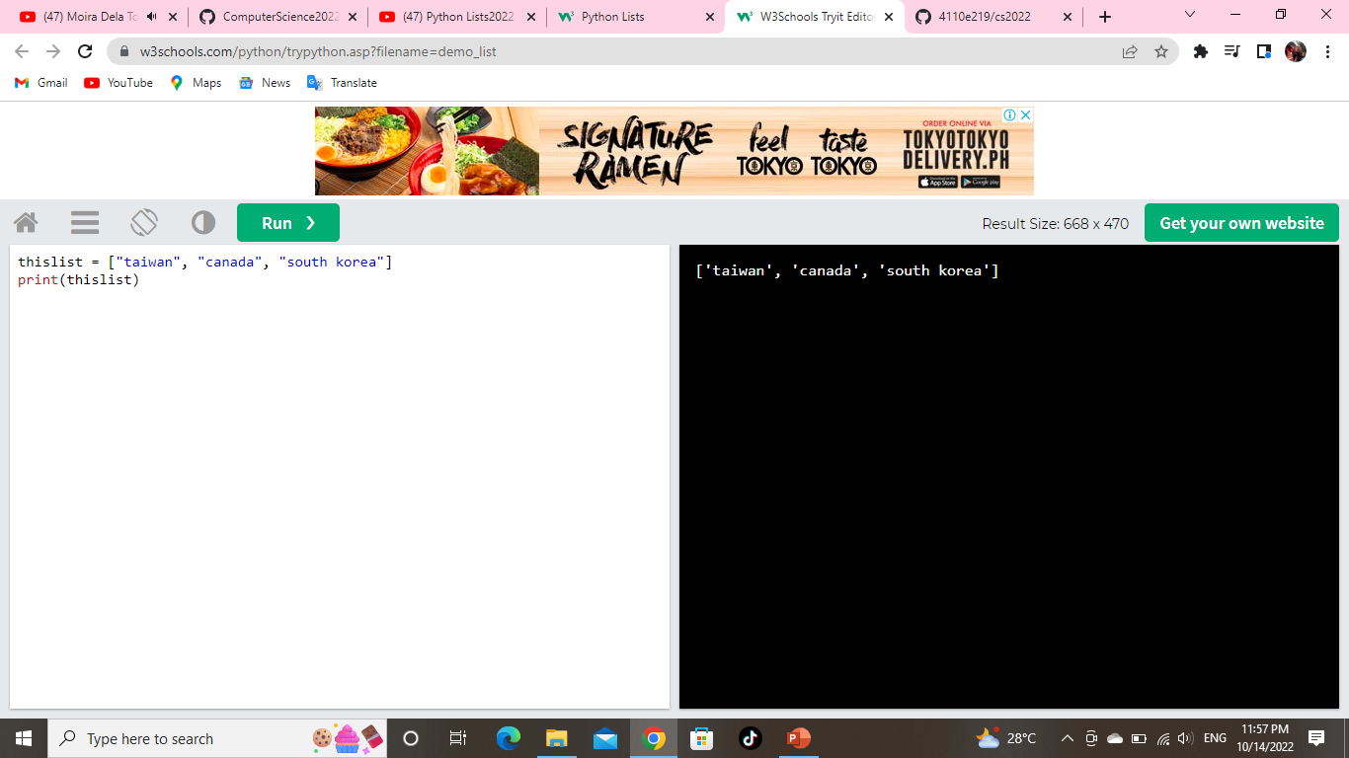
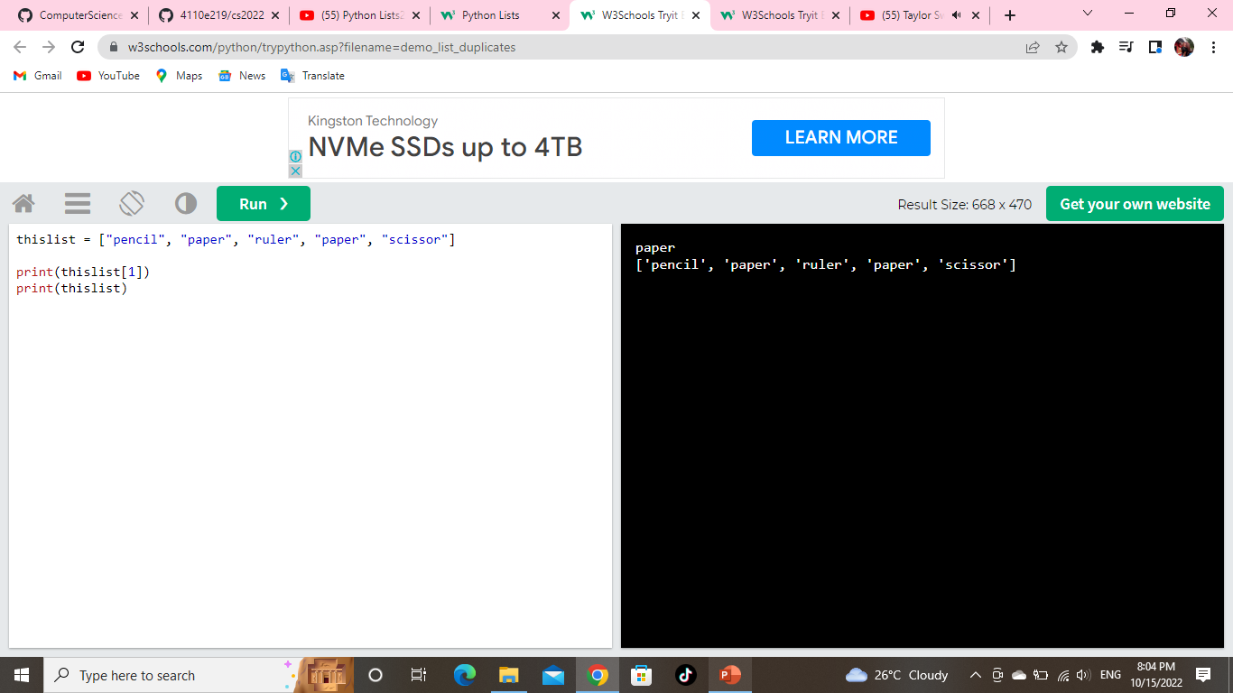
List
Lists are used to store multiple items in a single variable.
Lists are created using square brackets
Example: Create a List.
Allow Duplicates
Since lists are indexed, lists can have items with the same value:
Example: Lists allow duplicate values.

Slide 4
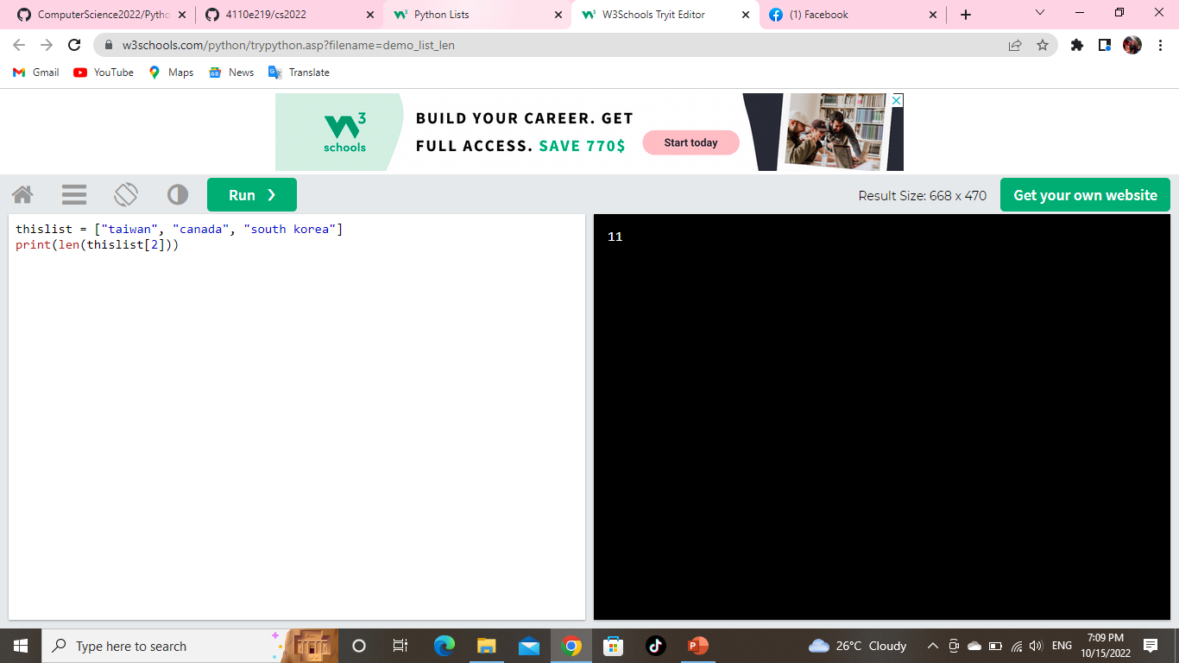
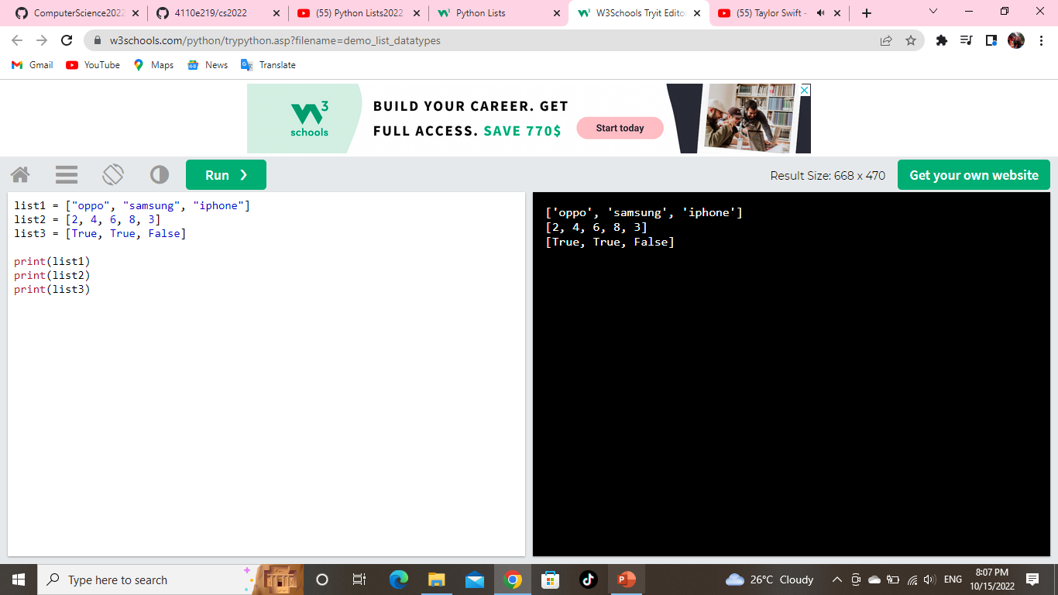
List Length
To determine how many items a list has, use the len() function:
Example: Print the number of items in the list.
List Items - Data Types
List items can be of any data type:
Example: String, int, and boolean data types:

Slide 5
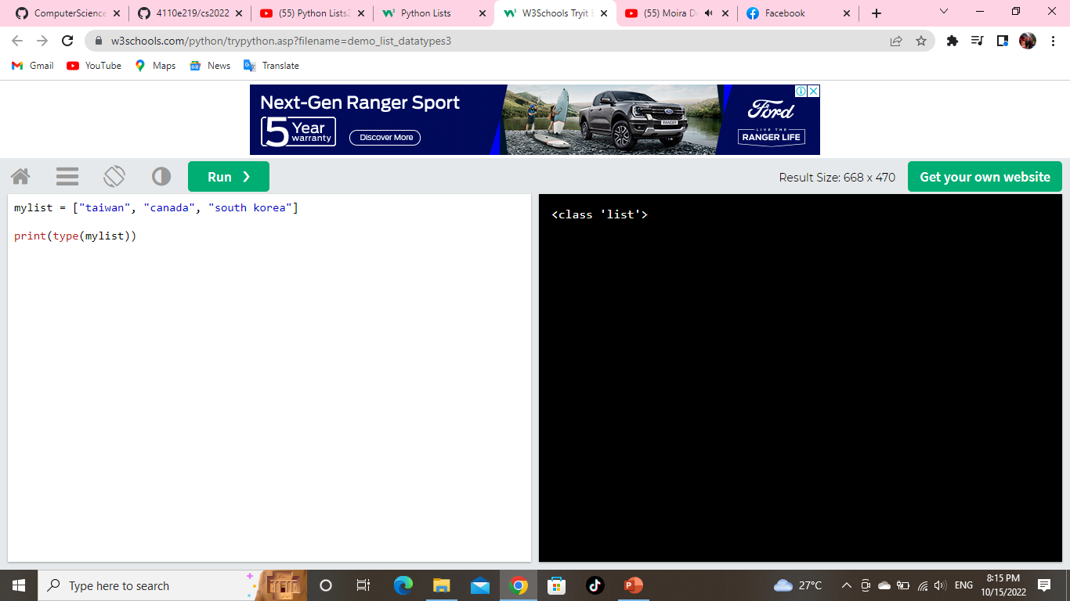
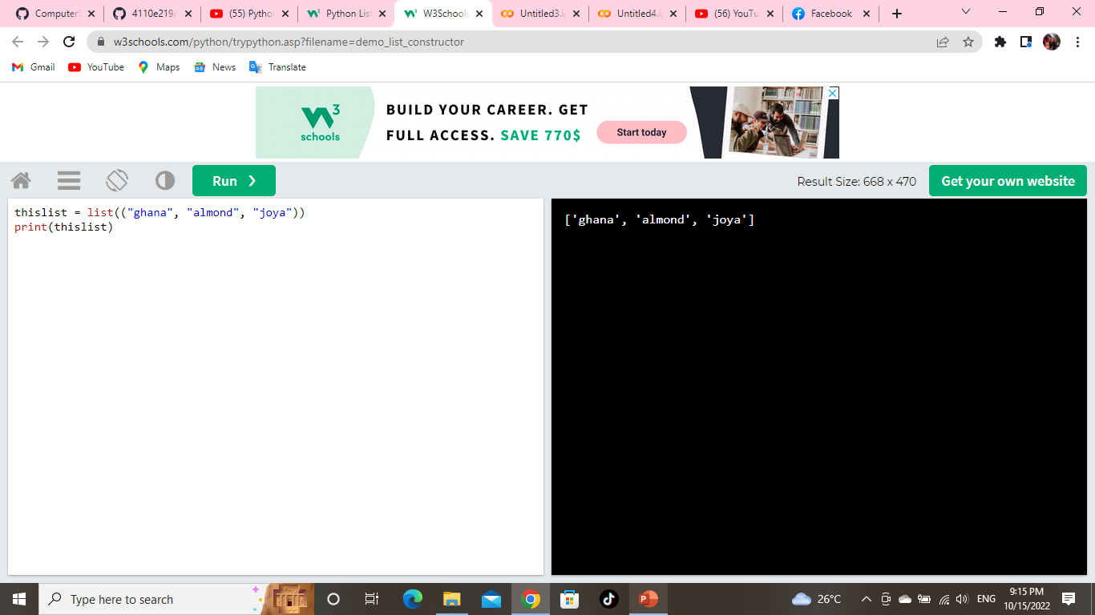
type()
From Python's perspective, lists are defined as objects with the data type 'list':
<class 'list’>
Example :
What is the data type of a list?
The list() Constructor
It is also possible to use the list() constructor when creating a new list.
Example
Using the list() constructor to make a List.

Slide 6

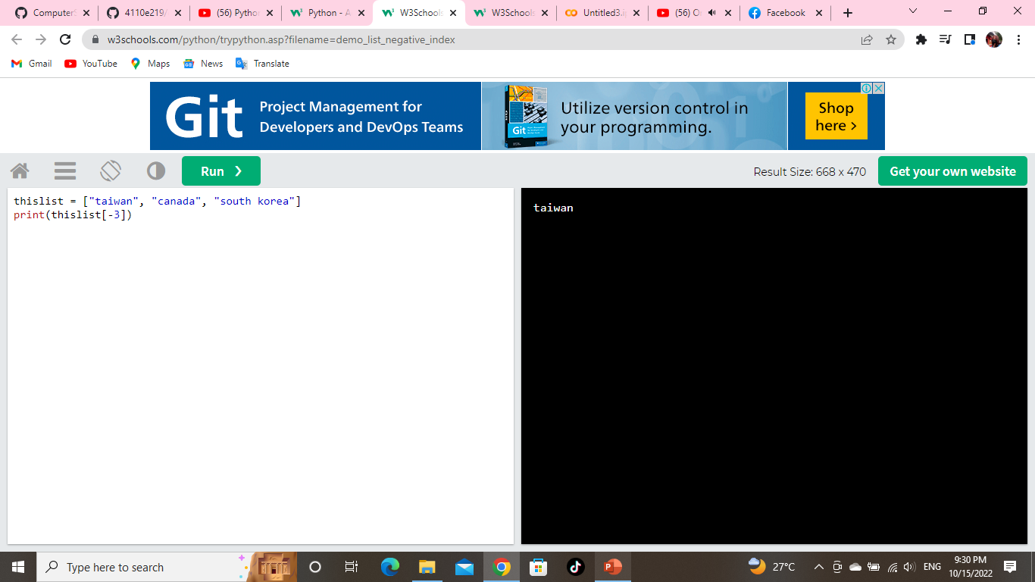
Python - Access List Items
Access Items
List items are indexed and you can access them by referring to the index number:
Example: Print the second item of the list
Negative Indexing
Negative indexing means starting from the end
-1 refers to the last item, -2 refers to the second last item, etc.
Example: Print the first item of the list:

Slide 7
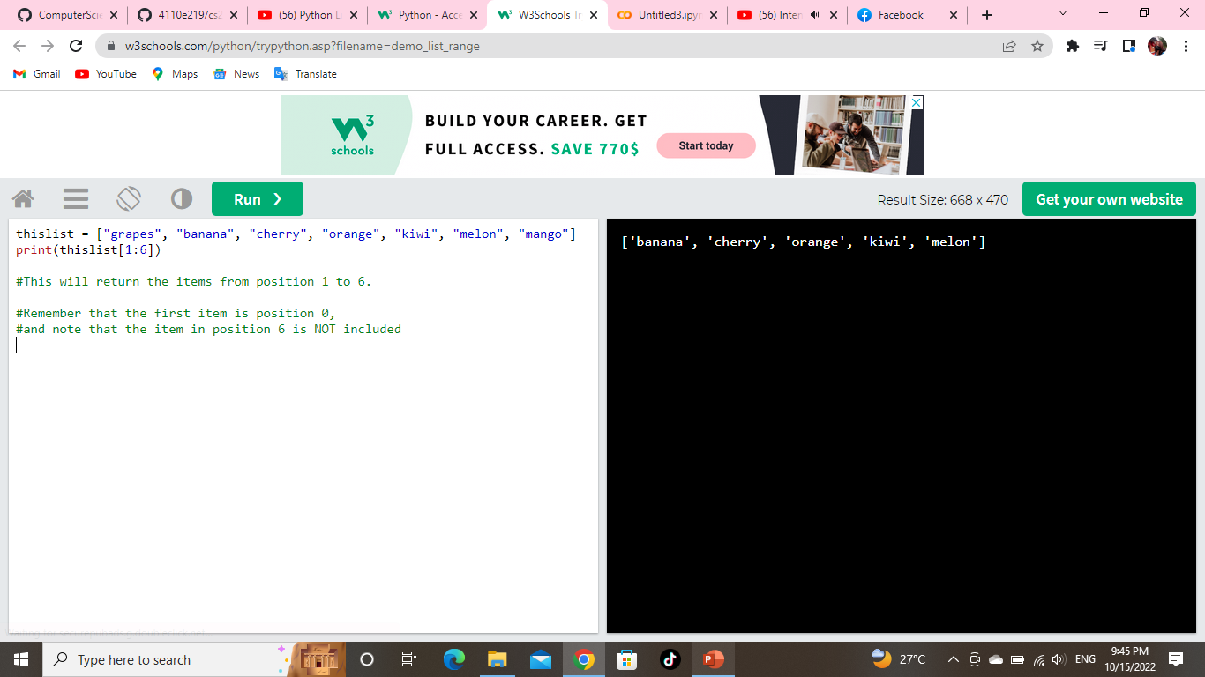

Range of Indexes
You can specify a range of indexes by specifying where to start and where to end the range.
When specifying a range, the return value will be a new list with the specified items.
Example: Return the second, third, fourth, fifth and sixth item.
Range of Negative Indexes
Specify negative indexes if you want to start the search from the end of the list:
Example: This example returns the items from “kiwi" (-5) to, but NOT including “melon" (-2):

Slide 8
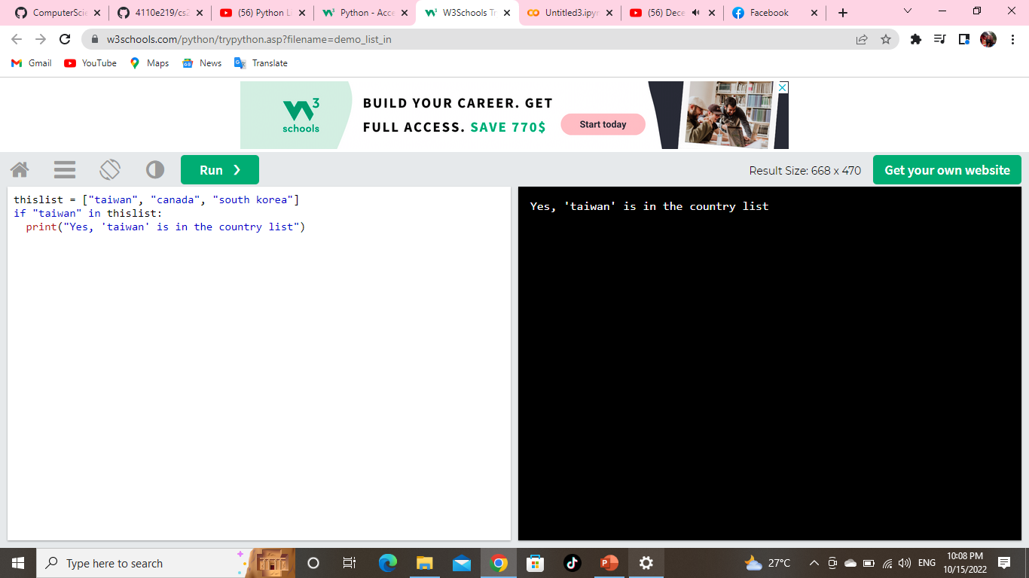
Check if Item Exists
To determine if a specified item is present in a list use the in keyword:
Example

Slide 9
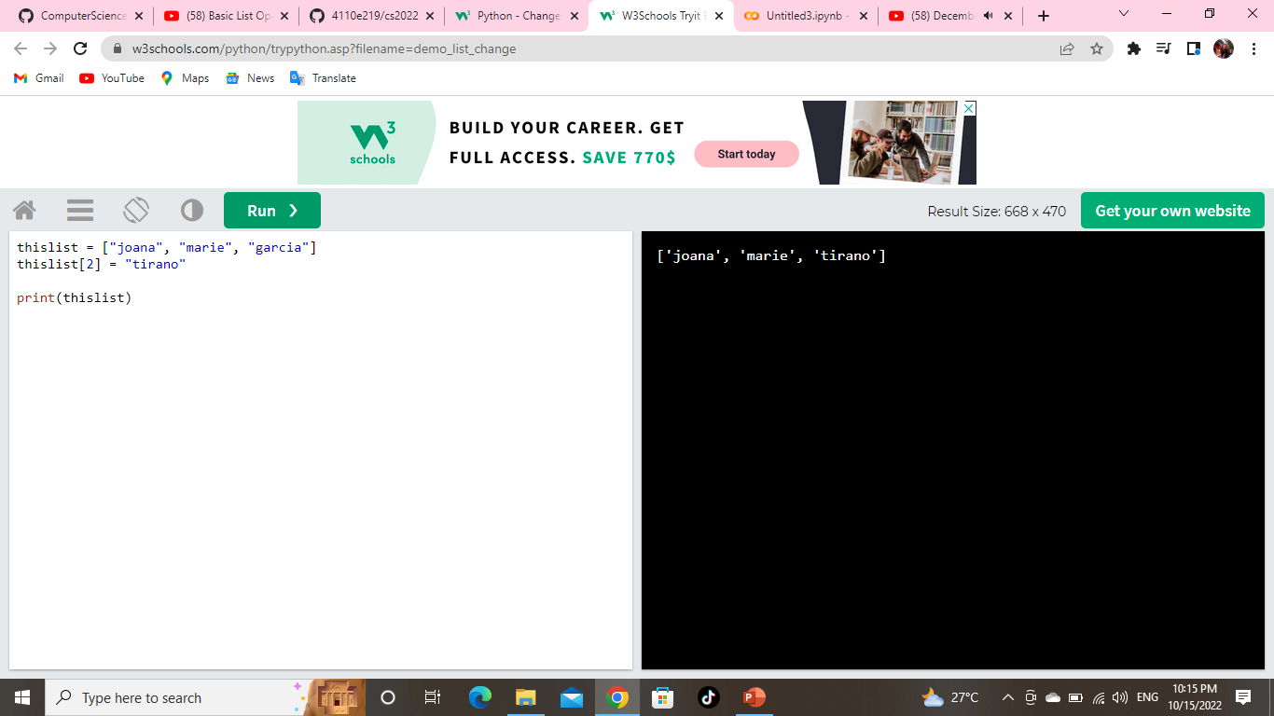
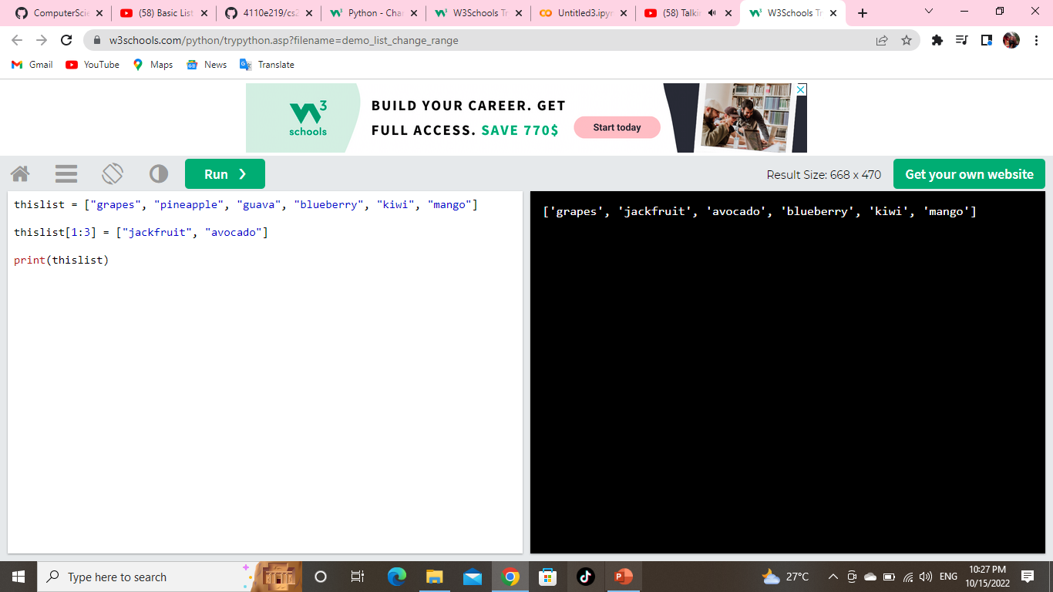
Python - Change List Items
Change Item Value
To change the value of a specific item, refer to the index number:
Example : Change the third item
Change a Range of Item Values
To change the value of items within a specific range, define a list with the new values, and refer to the range of index numbers where you want to insert the new values:
Example: Change the values “pineapple" and “guava" with the values “jackfruit" and “avocado":

Slide 10
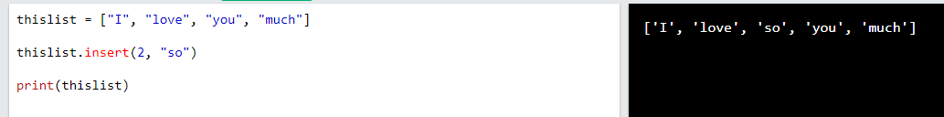
Insert Items
To insert a new list item, without replacing any of the existing values, we can use the insert() method.
The insert() method inserts an item at the specified index:
Example: Insert “so" as the third item

Slide 11
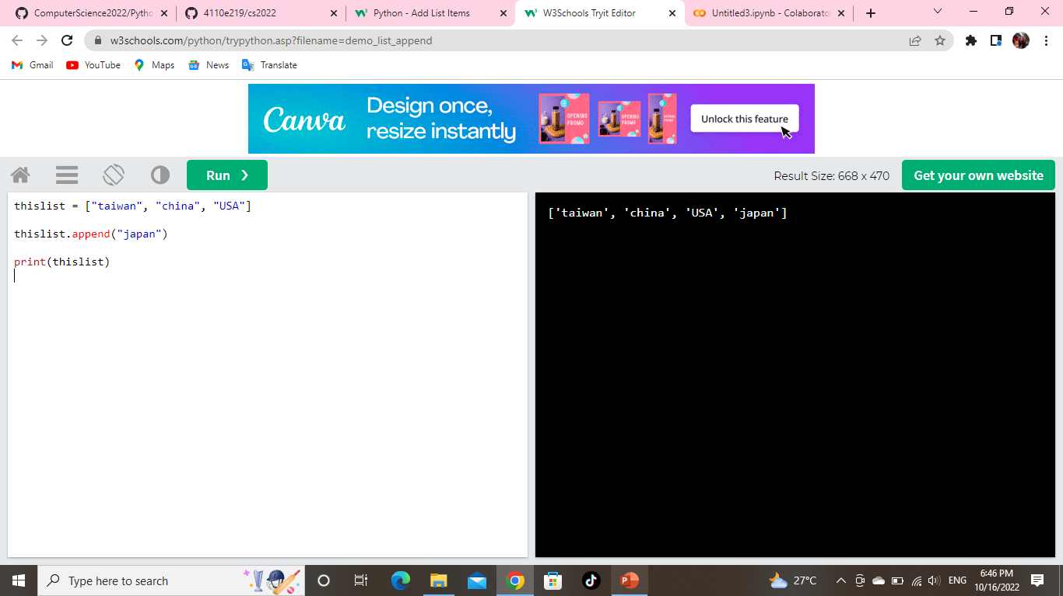
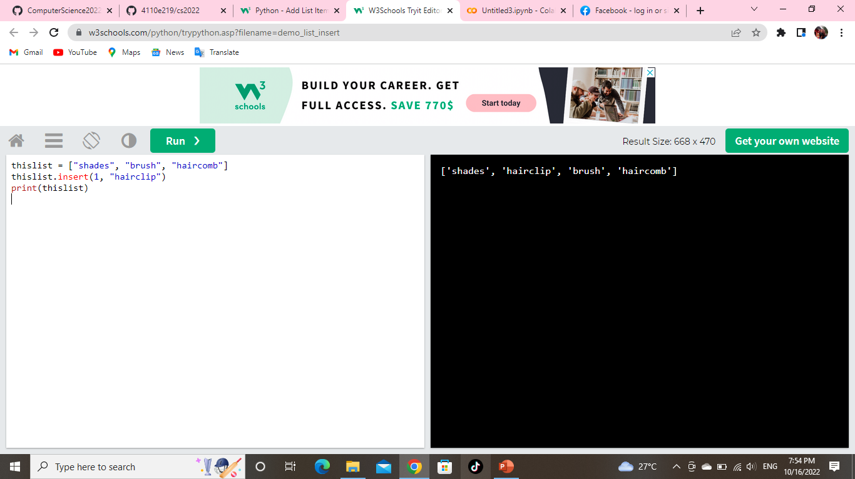
Python - Add List Items
Append Items
To add an item to the end of the list, use the append() method:
Example: Using the append() method to append an item:
Insert Items
To insert a list item at a specified index, use the insert() method.
The insert() method inserts an item at the specified index:
Example: Insert an item as the second position:

Slide 12
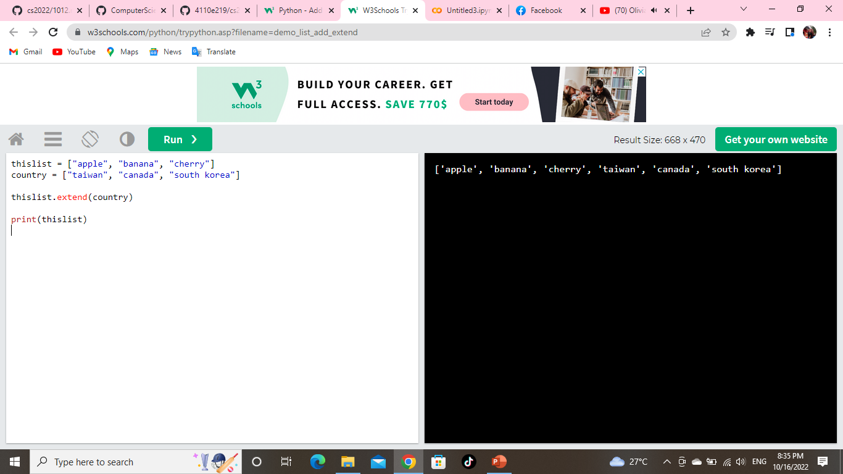
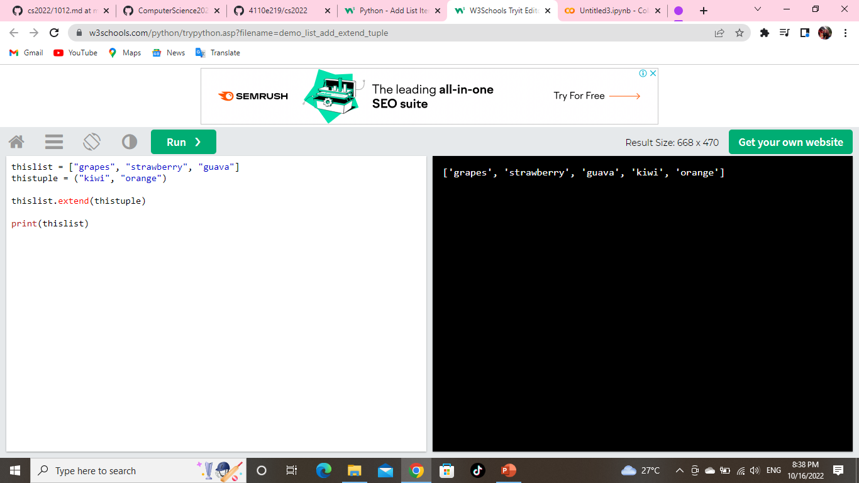
Extend List
To append elements from another list to the current list, use the extend() method.
Example: Add the elements of country to thislist:
Add Any Iterable
The extend() method does not have to append lists, you can add any iterable object (tuples, sets, dictionaries etc.).
Example: Add elements of a tuple to a list:

Slide 13

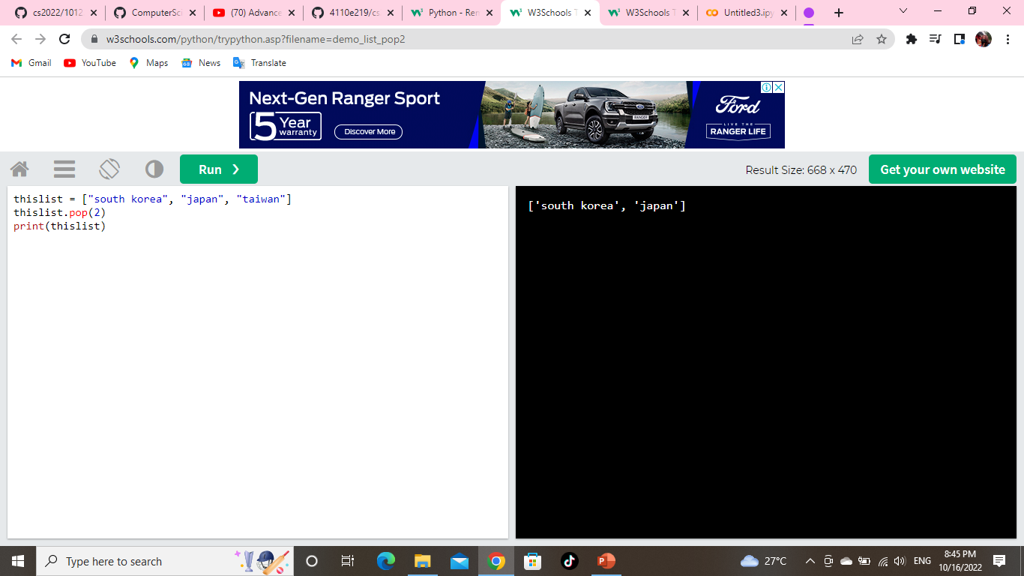
Python - Remove List Items
Remove Specified Item
The remove() method removes the specified item.
Example: Remove “marie":
Remove Specified Index
The pop() method removes the specified index.
Example: Remove the third item:

Slide 14

Clear the List
The clear() method empties the list. The list still remains, but it has no content.
Example: Clear the list content:

Slide 15
ADVANCED OPERATIONS IN PYTHON LIST

Slide 16

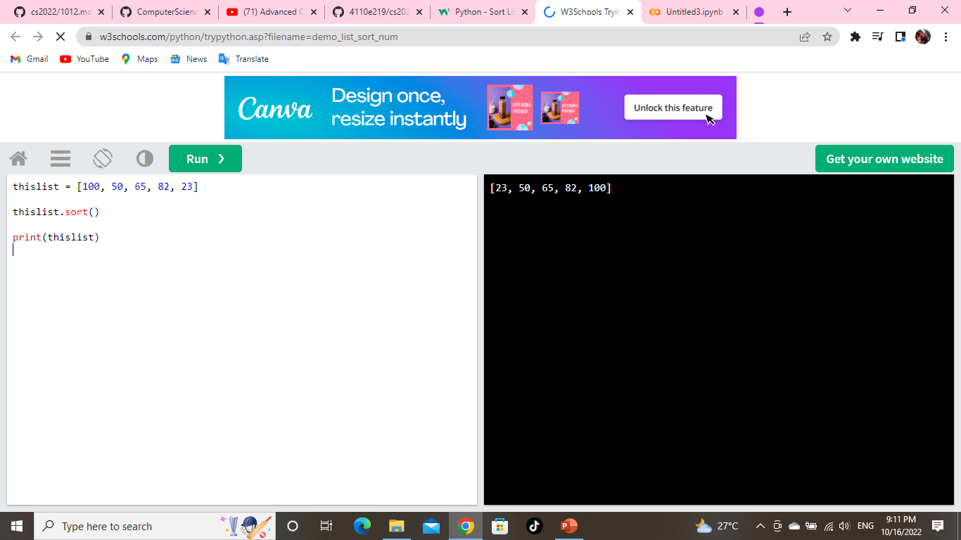
Python - Sort Lists
Sort List Alphanumerically
List objects have a sort() method that will sort the list alphanumerically, ascending, by default:
Example: Sort the list alphabetically:
Example: Sort the list numerically:

Slide 17
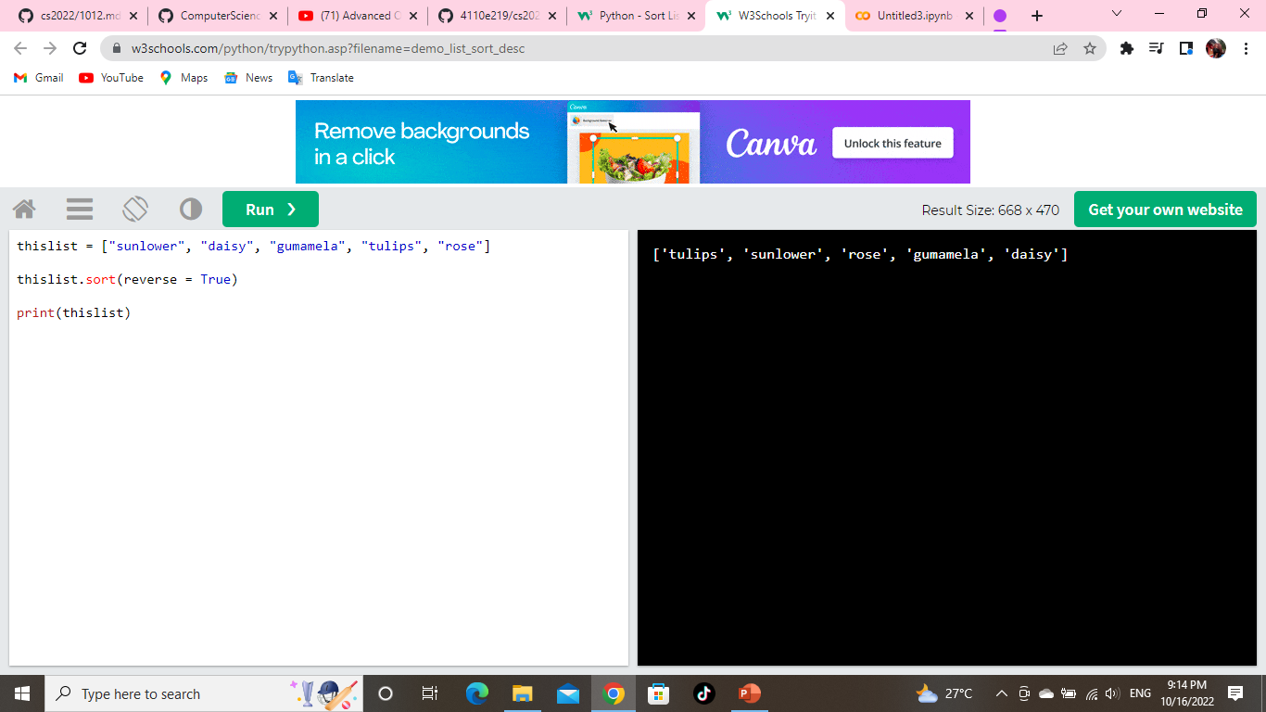

Sort Descending
To sort descending, use the keyword argument reverse = True:
Example: Sort the list descending:
Customize Sort Function
You can also customize your own function by using the keyword argument key = function.
The function will return a number that will be used to sort the list (the lowest number first):
Example: Sort the list based on how close the number is to 50:

Slide 18
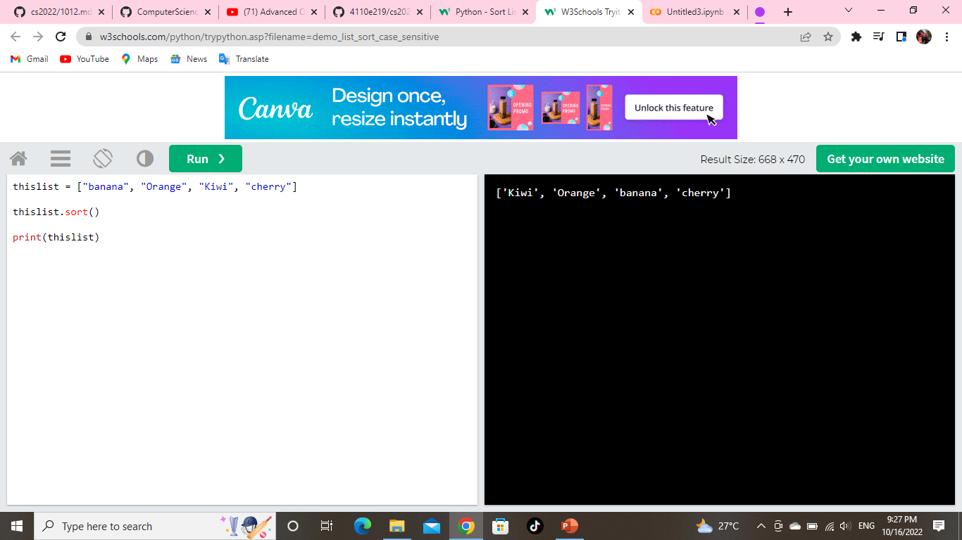

Case Insensitive Sort
By default the sort() method is case sensitive, resulting in all capital letters being sorted before lower case letters:
Example: Case sensitive sorting can give an unexpected result:
Reverse Order
What if you want to reverse the order of a list, regardless of the alphabet?
The reverse() method reverses the current sorting order of the elements.
Example: Reverse the order of the list items:

Slide 19



Python - Copy Lists
Copy a List
You cannot copy a list simply by typing list2 = list1, because: list2 will only be a reference to list1,
and changes made in list1 will automatically also be made in list2.
There are ways to make a copy, one way is to use the built-in List method copy().
Example: Make a copy of a list with the copy() method:
Another way to make a copy is to use the built-in method list().
Example: Make a copy of a list with the list() method:

Slide 20
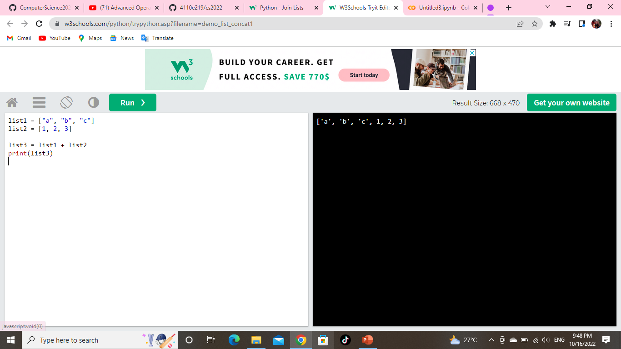
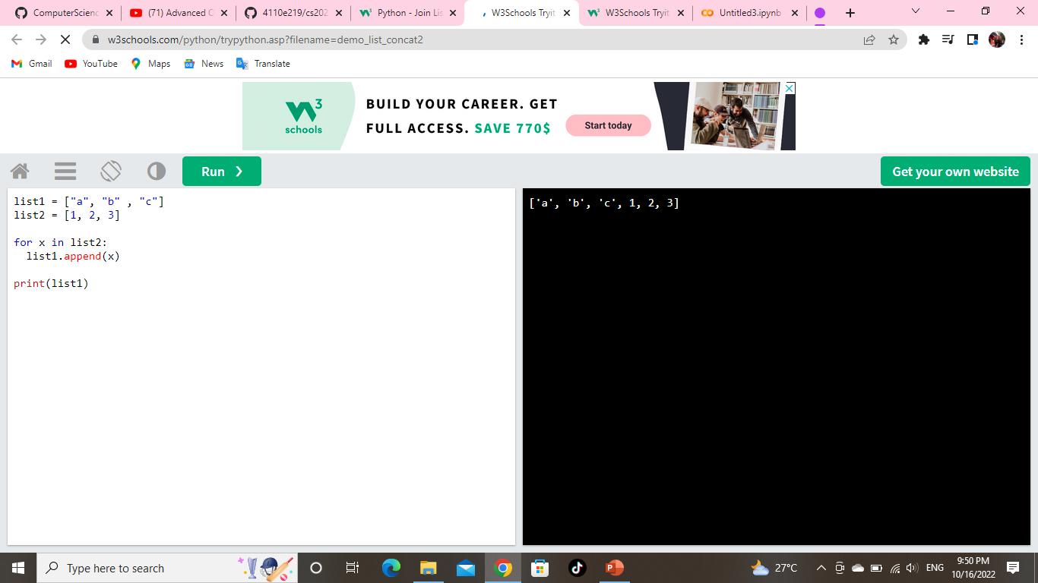
Python - Join Lists
Join Two Lists
There are several ways to join, or concatenate, two or more lists in Python.
One of the easiest ways are by using the + operator.
Example: Join two list:
Another way to join two lists is by appending all the items from list2 into list1, one by one:
Example: Append list2 into list1:

Slide 21
LIST METHOD

Slide 22
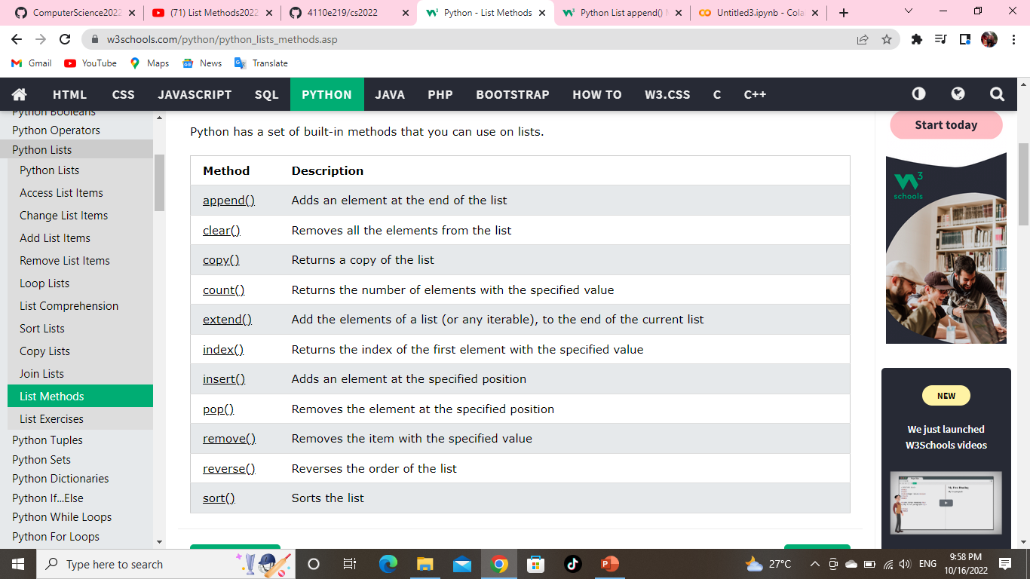
Python - List Methods
List Methods
Python has a set of built-in methods that you can use on lists.

Slide 23

Python List reverse() Method
Example: Reverse the order of the fruit list:

Slide 24
5. Data Structures
This chapter describes some things you’ve learned about already in more detail, and adds some new things as well.
5.1. More on Lists
The list data type has some more methods. Here are all of the methods of list objects:
list.append(x)
Add an item to the end of the list. Equivalent to a[len(a):] = [x].
list.extend(iterable)
Extend the list by appending all the items from the iterable. Equivalent to a[len(a):] = iterable.
list.insert(i, x)
Insert an item at a given position. The first argument is the index of the element before which to insert, so a.insert(0, x) inserts at the front of the list, and a.insert(len(a), x) is equivalent to a.append(x).

Slide 25
list.remove(x)
Remove the first item from the list whose value is equal to x. It raises a ValueError if there is no such item.
list.pop([i])
Remove the item at the given position in the list, and return it. If no index is specified, a.pop() removes and returns the last item in the list. (The square brackets around the i in the method signature denote that the parameter is optional, not that you should type square brackets at that position. You will see this notation frequently in the Python Library Reference.)
list.clear()
Remove all items from the list. Equivalent to del a[:].
list.index(x[, start[, end]])
Return zero-based index in the list of the first item whose value is equal to x. Raises a ValueError if there is no such item.

Slide 26
The optional arguments start and end are interpreted as in the slice notation and are used to limit the search to a particular subsequence of the list. The returned index is computed relative to the beginning of the full sequence rather than the start argument.
list.count(x)
Return the number of times x appears in the list.
list.sort(*, key=None, reverse=False)
Sort the items of the list in place (the arguments can be used for sort customization, see sorted() for their explanation).
list.reverse()
Reverse the elements of the list in place.
list.copy()
Return a shallow copy of the list. Equivalent to a[:].

Slide 27
THANK YOU!!! FOR YOUR ATTENTON.

